Slide 1


Slide 2

So far: our search problems have assumed agent has complete control of environment.
State does not change unless the agent (robot) changes it.
All we need to compute is a single path to a goal state.
In stochastic, Multiagent environment, problem is you might not traverse the path you are expecting.
In such cases, we need to generalize our view of search to handle state changes that are not in the control of the agent.
One generalization yields game tree search.

Slide 3

Multi-agent environment: every agent needs to consider the actions of the other agents, in order to optimize its own welfare
  Cooperative: Agents act collectively to achieve a common goal
  Competitive:
    Agents compete against each other
    Their goals are in conflict
    Gives rise to the concept of adversarial search problems – often known as games.

Slide 4

MAE as a game provided that the impact of each agent on the other is “significant”, i.e., able to affect the actions of the other agent(s).
In AI, “game” is a specialized concept:
  Deterministic, fully-observable environments
  Two agents whose actions must alternate
  Utility values at the end of the game are always equal and opposite
    +1 = Chess winner
    -1 = Chess looser.

Slide 5

Tackled by Konrad Zuse, Claude Shannon, Norbert Wiener, Alan Turing
  Have seen lot of successes recently, e.g., DeepBlue
Game states are easy to represent:
Agents are restricted by a limited action rules
Outcomes defined by precise rules
Games:
  Chess: average branching factor of 35
  If 50 moves by each player, search tree has 35¹⁰⁰ nodes!
  Heuristic search procedure is needed.

Slide 6

In typical search problems, we optimize a measure to acquire the goal: there is no opponent
In games, there is an "Unpredictable" opponent
  Need to specify a move for every possible opponent reply
  Stringent time constraints
  Unlikely to find goal, must approximate
  Requires some type of a decision to move the search forward.
  Strict penalty on an inefficient move

Slide 7

Two-person
■ chess, checkers, tic-tac-toe, backgammon, go, Doom, “find the last parking space”
■ Your winning means that your opponent looses, and vice-versa.
■ Zero-sum means the sum of your and your opponent’s payoff is zero---any thing you gain come at your opponent’s cost (and vice-versa).
Key insight: how you act depends on how the other agent acts (or how you think they will act) and vice versa (if your opponent is a rational player)

Slide 8

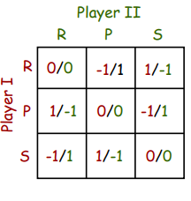
You can start the game by selecting "rock", "scissors" or "paper".
Choose continuously until you create a pattern (given).
Represented as a matrix:
Player I chooses a row, Player II chooses a column
●Payoff to each player in each cell (P.I / P.II)
●1: win, 0: tie, -1: loss
■ so it’s zero-sum

Slide 9

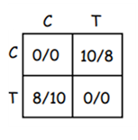
Two robots: Blue and Red
■ one cup of coffee, one tea left
■ both C & F prefer coffee (value 10)
■ tea acceptable (value 8)
●Both robots go for Coffee
■ collide and get no payoff
●Both go for tea: same
●One goes for coffee, other for tea:
■ coffee robot gets 10
■ tea robot gets 8

Slide 10

Imagine 2 players of tic-tac-toe: MAX and MIN
Players alternate moves (starting with Max)
  We can generate a game tree
  The terminal states are at the leaves
MAX should play in order to maximize its utility, which will minimize the utility for MIN
■ Max gets U(t), Min gets –U(t) for terminal node
■This is why called a Zero-Sum Game.

Slide 11
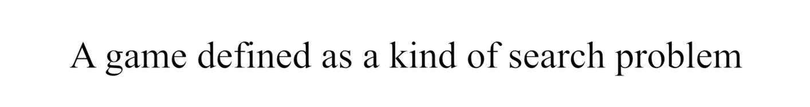
S0: The initial state, which specifies how the game is set up at the start.
PLAYER(s): Defines which player has the move in a state.
ACTIONS(s): Returns the set of legal moves in a state.
RESULT(s, a): The transition model, which defines the result of a move.
TERMINAL-TEST(s): A terminal test, which is true when the game is over and false, otherwise.
UTILITY(s, p): A utility function (also called an objective function or payoff function), defines the final numeric value for a game that ends in terminal state s for a player p.

Slide 12
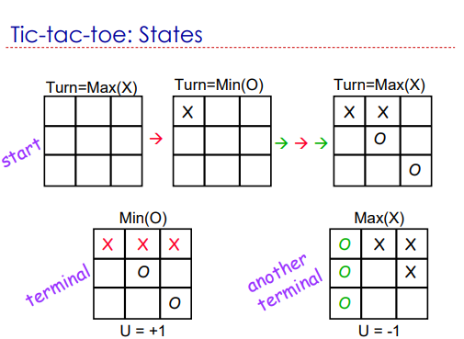

Slide 13

The initial state, ACTIONS function, and RESULT function define the game tree for the game where the nodes are game states and the edges are moves.
Play alternates between MAX’s placing an X and MIN’s placing an O until we reach leaf nodes corresponding to terminal states .
In terminal states one player has three in a row or all the squares are filled.
The number on each leaf node indicates the utility value of the terminal state from the point of view of MAX;
High values are assumed to be good for MAX and bad for MIN

Slide 14
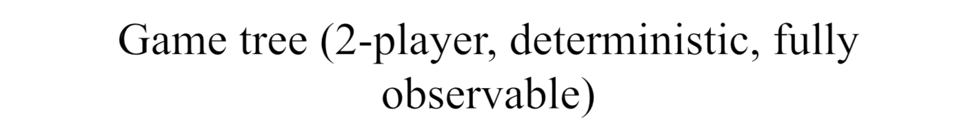

Layers reflect the alternating moves
This terminal state is one of the worst for MAX and one of the best for MIN
This terminal state is one of the best for MAX and one of the worst for MIN

Slide 15
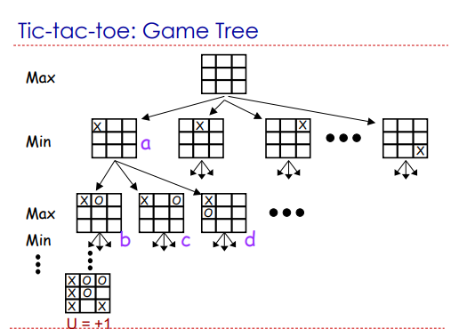

Slide 16

Max doesn’t decide where to go alone
■ after Max moves to state a, Min decides whether to move to state b, c, or d
●Thus Max must have a next strategy
■ must know what to do next no matter what move Min makes (b, c, or d)
■ Max may want to do something different in response to b, c, or d
●What is a reasonable strategy?

Slide 17

This is a MAE
  In discovering the sequence of optimal moves by MAX, we have to consider that MIN is taking moves as well.
  So, the optimal strategy will tell how should MAX play against MIN (by considering the moves of the latter), in order to win the game.

Slide 18

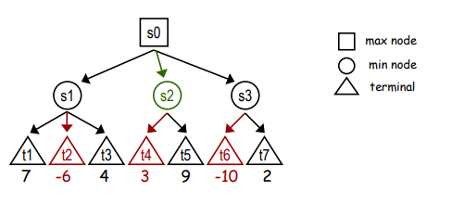
Consider a shortened game tree oTIC-TAC-TOE
  Numbers are the utilities
  Ply: a move by MAX followed by a move from MIN. Algorithm is recursive,

Slide 19

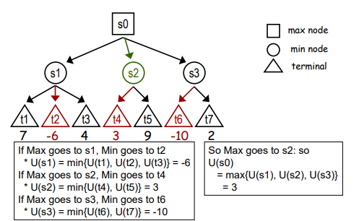
● Build full game tree (all leaves are terminals)
■ root is start state, edges are possible moves, etc.
■ label terminal nodes with utilities
● Back values up the tree

Slide 20
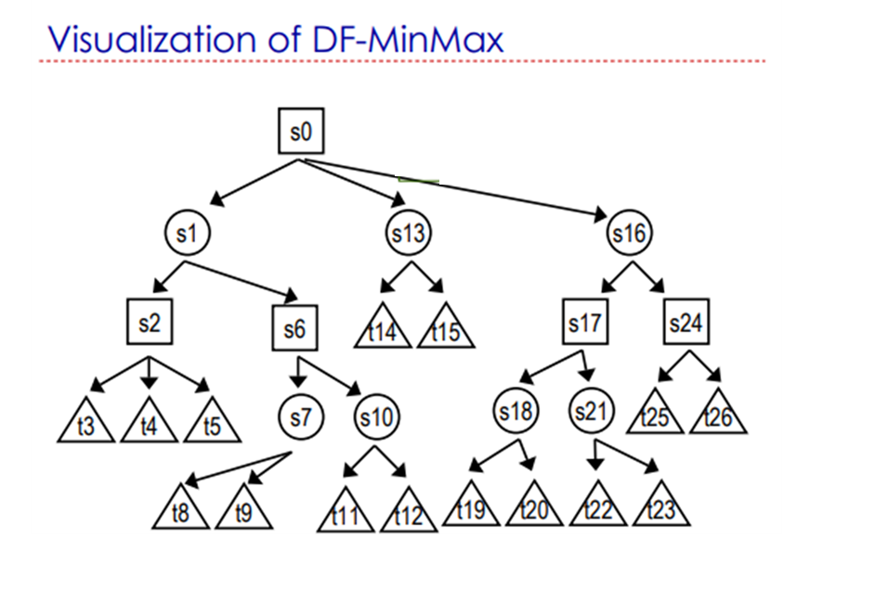

Slide 21
The minimax algorithm performs a complete depth-first exploration of the game tree.
If the maximum depth of the tree is m and there are b legal moves at each point, then the time complexity of the minimax algorithm is O(b^{m}).
The space complexity is O(bm) for an algorithm that generates all actions at once, or O(m) for an algorithm that generates actions one at a time.
For real games, of course, the time cost is totally impractical, but this algorithm serves as the basis for the mathematical analysis of games and for more practical algorithms.

Slide 22
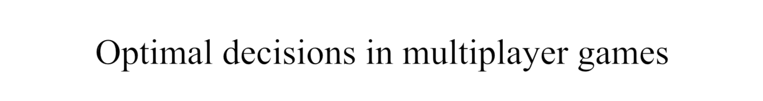
How to apply the minimax concept to multiplayer games?
First, we need to replace the single value for each node with a vector of values.
For example, in a three-player game with players A, B, and C, a vector < v_{A}, v_{B}, v_{C} > is associated with each node.
For terminal states, the vector gives the utility of the state from each player’s viewpoint.
The simplest way to implement this is to have the UTILITY function return a vector of utilities.

Slide 23


Depth-First Exploration
Recursion: Winds all the way to the terminal nodes, and then unwinds back by backing up the values
Min(minimax) for MIN moves
Max(minimax) for MAX moves

Slide 24

Complete? Yes (if tree is finite)
Optimal? Yes (against an optimal opponent)
Time complexity? O(b^{m})
Space complexity? O(bm) (depth-first exploration)
For chess, b ≈ 35, m ≈100 for "reasonable" games → exact solution completely infeasible
  We need to think of a way to cut down the number of search paths.

Slide 25

It is not necessary to examine entire tree to make correct MiniMax decision.
Assume depth-first generation of tree.
■ After generating value for only some of n’s children we can prove that we’ll never reach n in a MinMax strategy.
■ So we needn’t generate or evaluate any further children of n
Two types of pruning (cuts):
■ pruning of MAX nodes (α-cuts)
■ pruning of MIN nodes (β-cuts)
ALPHA–BETA pruning when applied to a standard minimax tree, it returns the same move as minimax would, but prunes away branches that cannot possibly influence the final decision.

Slide 26
Two-parameter can be defined as:
  Alpha: The best (highest-value) choice we have found so far at any point along the path of Maximizer. The initial value of alpha is -∞.
  Beta: The best (lowest-value) choice we have found so far at any point along the path of Minimizer. The initial value of beta is +∞.
  While backtracking the tree, the node values pass to upper nodes instead of values α, β
  α, β values are passed to child nodes.
  Remove all the nodes which are not really affecting the final decision but making algorithm slow.
  Hence by pruning these nodes, it makes the algorithm fast.
  Condition to prune a node: α>=β

Slide 27
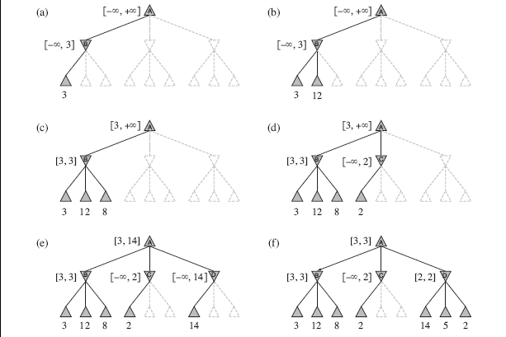
At each point, we show the range of possible values for each node. (a) The first leaf below B has the value 3. Hence, B, which is a MIN node, has a value of at most 3. (b) The second leaf below B has a value of 12; MIN would avoid this move, so the value of B is still at most 3.
(c) The third leaf below B has a value of 8; we have seen all B’s successor states, so the
value of B is exactly 3. Now, we can infer that the value of the root is at least 3, because
MAX has a choice worth 3 at the root.

Slide 28

(d) The first leaf below C has the value 2. Hence, C, which is a MIN node, has a value of at most 2.
But we know that B is worth 3, so MAX would never choose C. Therefore, no point in looking at the other successor states of C.
(e) The first leaf below D has the value 14, so D is worth at most 14. This is still higher than MAX’s best alternative (i.e., 3), so we need to keep exploring D’s successor states.
We now have bounds on all of the successors of the root, so the root’s value is also at most 14.
(f) The second successor of D is worth 5, so again we need to keep exploring.
The third successor is worth 2, so now D is worth exactly 2. MAX’s decision at the root is to move to B, giving a value of 3.

Slide 29
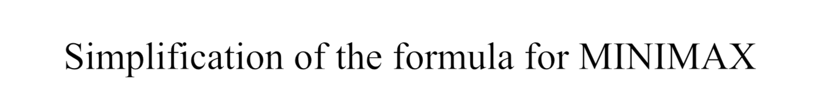

Let the two unevaluated successors of node C have values x and y.
Then the value of the root node is given by
In other words, the value of the root and hence the minimax decision are independent of the values of the pruned leaves x and y.
Alpha–beta pruning can be applied to trees of any depth, and it is often possible to prune entire subtrees rather than just leaves.

Slide 30
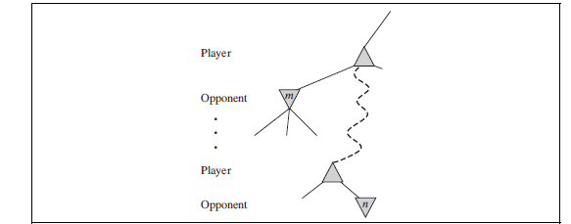
The general principle is: consider a
node n somewhere in the tree such
that Player has a choice of moving to that node.
If Player has a better choice m either at the parent node of n or at any choice point further up, then n will never be reached in actual play.
So once we have found out enough about n (by examining some of its descendants) to reach this conclusion, we can prune it.
Remember that minimax search is depth-first, so at any one time we just have to consider
the nodes along a single path in the tree. Alpha–beta pruning gets its name from the
following two parameters that describe bounds on the backed-up values that appear any where along the path
α = the value of the best (i.e., highest-value) choice we have found so far at any choice point along the path for MAX.
β = the value of the best (i.e., lowest-value) choice we have found so far at any choice point along the path for MIN.
Alpha–beta search updates the values of α and β as it goes along and prunes the remaining
branches at a node (i.e., terminates the recursive call) as soon as the value of the current
node is known to be worse than the current α or β value for MAX or MIN, respectively.

Slide 31

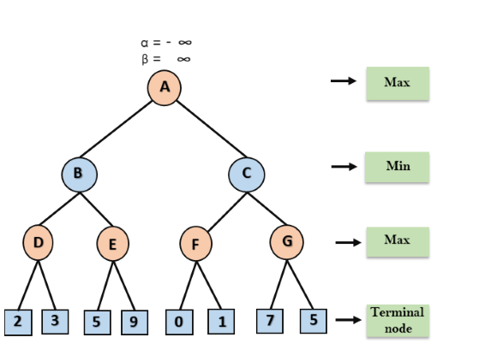
Step 1: At the first step the, Max player will start first move from node A where α= -∞ and β= +∞, these value of alpha and beta passed down to node B where again α= -∞ and β= +∞, and Node B passes the same value to its child D.

Slide 32
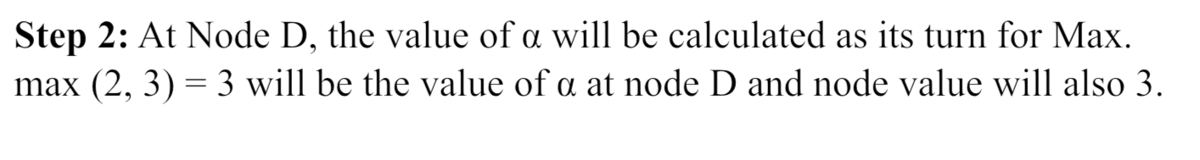
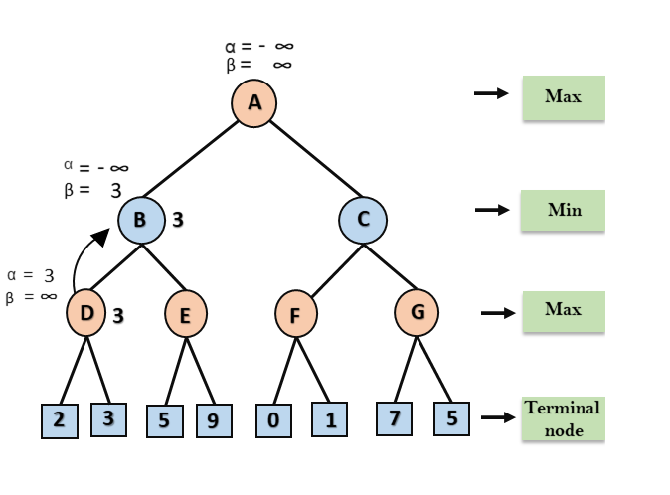
Step 3: Algorithm backtrack to node B,
where the value of β
will change as this
is a turn of Min,
Now β= +∞, will
compare with the
available subsequent
nodes value, i.e.
min (∞, 3) = 3, hence
at node B now α= -∞,
and β= 3.
In the next step, algorithm
traverse the next successor
of Node B which is node E,
and the values of α= -∞, and
β= 3 will also be passed.

Slide 33
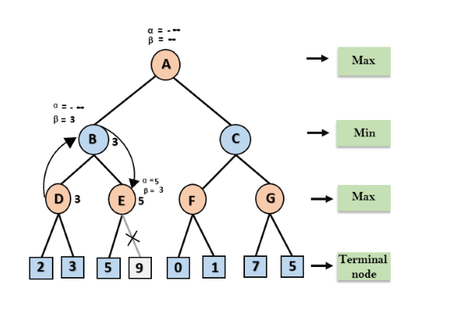
Step 4: At node E, Max will take its turn, and the value of alpha will change.
The current value of alpha will be compared with 5, so max (-∞, 5) = 5, hence at node E, α= 5 and β= 3, where α>=β, so the right successor of E will be pruned, and algorithm will not traverse it, and the value at node E will be 5.

Slide 34
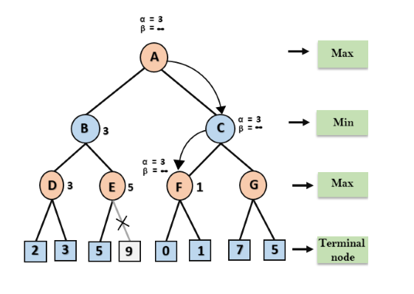
Step 5: Algorithm again backtrack the tree, from node B to node A, the value of alpha will be changed the maximum available value is 3 as max (-∞, 3)= 3, and β= +∞, these two values now passes to right successor of A which is Node C.
At node C, α=3 and β= +∞, and the same values passed on to node F.
Step 6: At node F, again the value of α will be compared with left child which is 0, and max(3,0)= 3, and then compared with right child which is 1, and max(3,1)= 3 still α remains 3, but the node value of F will become 1.

Slide 35
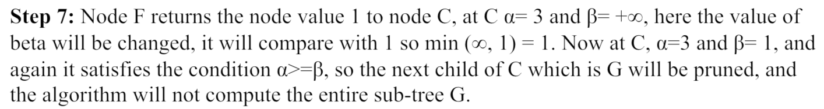
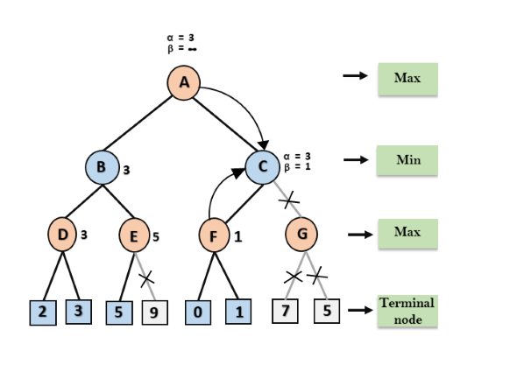

Slide 36
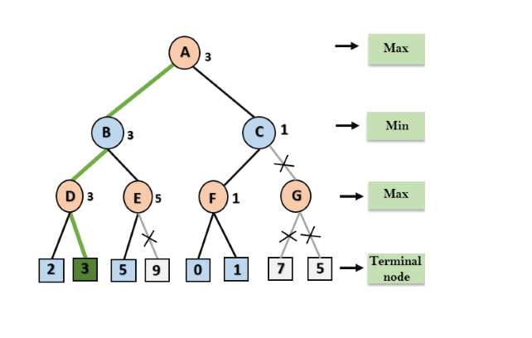
Step 8: C now returns the value of 1 to A here the best value for A is max (3, 1) = 3. Following is the final game tree which is the showing the nodes which are computed and nodes which has never computed. Hence the optimal value for the maximizer is 3 for this example.

Slide 37
The effectiveness of alpha–beta pruning is highly dependent on the order in which the states are examined. For example, in Figure 5.5(e) and (f), we could not prune any successors of D at all because the worst successors (from the point of view of MIN) were generated first.
If the third successor of D had been generated first, we would have been able to prune the other two.
This suggests that it might be worthwhile to try to examine first the successors that are likely to be best.

Slide 38
If this can be then it turns out that alpha–beta needs to examine only O(bm/2)nodes to pick the best move, instead of O(bm) for minimax. This means that the effective branching factor becomes √b instead of b—for chess, about 6 instead of 35.
Put another way, alpha–beta can solve a tree roughly twice as deep as minimax in the same amount of time.
If successors are examined in random order rather than best-first, the total number of nodes examined will be roughly O(bm/4) for moderate b.
For chess, a fairly simple ordering function (such as trying captures first, then threats, then forward moves, and then backward moves) gets you to within about a factor of 2 of the best-case O(bm/2) result.

Slide 39
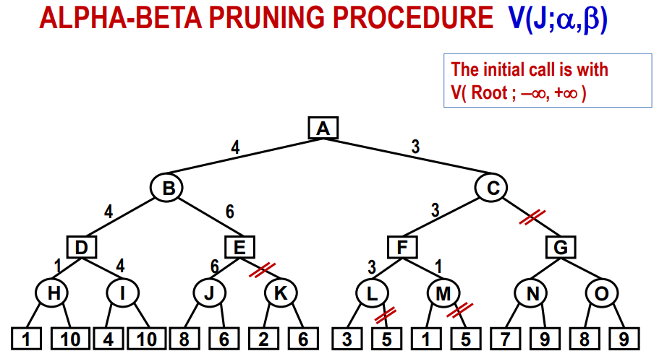

Slide 40




Slide 41

Pruning does not affect final result
Good move ordering improves effectiveness of pruning
With "perfect ordering," time complexity = O(b^{m/2})
  → doubles depth of search
A simple example of the value of reasoning about which computations are relevant (a form of meta-reasoning)

